Slide 1
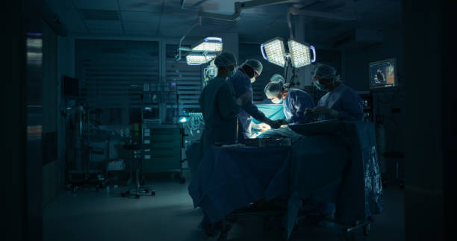
Surgical Skill Assessment using Graph-Based Modeling
-Using the JIGSAWS Dataset for Skill Evaluation
Presented by:
Under the Guidance of:
Dr.P Lavanya
Head&Professor of CSE Department
Gouni Sahithi - | Methodist College of Engineering and Technology. | Computer Science and Engineering.

Slide 2
Abstract:
This project presents an automatic way to judge a surgeon's skill by looking at their surgery videos.
Instead of relying on human opinion, we use a smart computer model called a 'graph.' This model treats everything in the video—the surgical tools, the parts, and all the actions—as connected pieces of information. By mapping out these relationships and how they change moment-to-moment, the model can understand the full context of the operation.
In this project, we use deep learning to automatically recognize different surgical gestures and assess skill levels from motion (kinematic) data. The data comes from the JIGSAWS dataset, which records the movements of surgical tools during robotic surgery tasks.
I designed a model using Graph Convolutional Networks (GCN) and LSTM (Long Short-Term Memory) networks to capture both the relationships between robot joints and how movements change over time. This system can help in creating an automated, objective, and faster way to evaluate surgical training.

Slide 3
Introduction:
Surgical-skill-assessment: Evaluation of a surgeon’s performance.
A Surgery video :is a real-time video feed from the body, displayed on a monitor during surgery.
Graph-based modeling is a method of structuring data to represent relationships between entities using a network of nodes (entities) and edges (relationships)
Graph Convolutional Network, a type of neural network used for graph-structured data.
Long Short-Term Memory (LSTM):used for storing data in memory.

Slide 4
Problem Statement:
Evaluating surgical skill is a crucial part of training new surgeons. However, current assessment methods are:
  1.Time-consuming, since experts must watch and score each video manually.
  2.Subjective, because different evaluators may score differently.
This project aims to develop an AI-based system that can learn from videos and predict the surgeons level.

Slide 5
Objectives:
Build a deep learning model that combines GCN and LSTM:
GCN (Graph Convolutional Network) helps learn relationships between the surgeon’s and instrument joints.
LSTM (Long Short-Term Memory) helps understand how movements change over time.
Build a model that can recognize different surgical actions from videos.
To evaluate the surgeon’s skill level(e.g., beginner, intermediate, or expert).

Slide 6
The JIGSAWS Dataset:
The JIGSAWS dataset (JHU-ISI Gesture and Skill Assessment Working Set) is used for this project.
It contains recordings of surgery tasks:
  Suturing
  Knot Tying
  Needle Passing
Each task includes:
  Kinematic data: tool movements and positions over time.
  Transcriptions: video frames
  Video recordings.
Surgeons are labeled A to I, each performing multiple trials (001–005).
There are 15 different gestures in total (G1–G15).

Slide 7
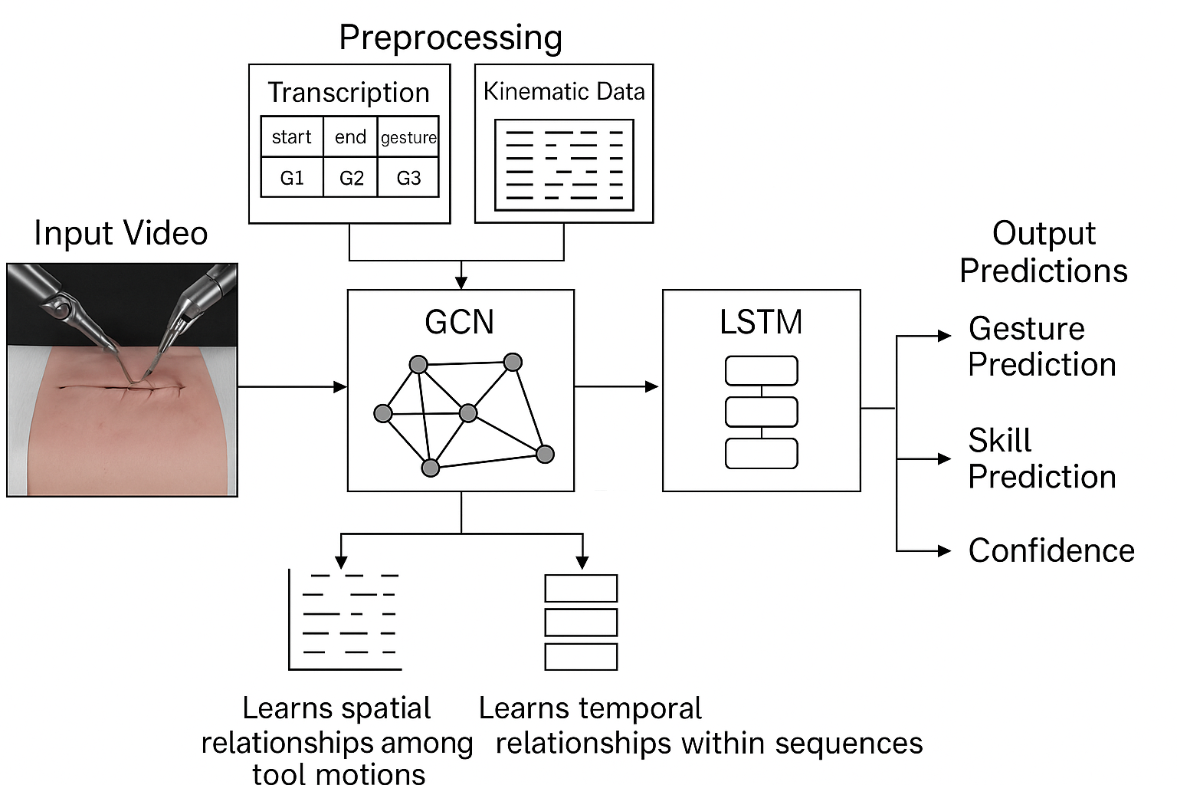
Model Architecture:

Slide 8
Training Process:
The Hardware Bottleneck (CPU): Trained our model on a CPU. A CPU is a general-purpose processor, making it much slower for the kind of parallel math required for deep learning compared to a specialized GPU. This means each training epoch took a significantly longer time.
The Consequence :Because training on a CPU is slow, running for 20 epochs was a practical limit. While the model got to see the entire dataset 100 times, it was likely not enough "study time" to learn the very complex and subtle patterns in the surgical data.
The Outcome (50% Accuracy):As we haved trained on CPU we trained only 20 epochs. So due to this we got accuracy of 50%.So,further we train on GPU and try to get accuracy of 80+.

Slide 9
Results and Observations:
After training the model:
  The loss value decreased steadily, showing learning progress.
  The gesture accuracy reached around 25–30%, which indicates the model can recognize some gestures correctly but still needs improvement.
  Accuracy can vary based on how much data is available and its quality.
  Although the accuracy is not very high yet, the results confirm that the approach works and can be improved with cleaner data and better tuning.

Slide 10
Challenges:
Small Dataset(Under Fitting).
Missing or misplaced transcription and kinematic files.
Large data size leading to longer training times.
Variation in how different surgeons perform actions.
Training on CPU took longer time.
These issues affected training accuracy but also helped identify key areas for future improvement.

Slide 11
Future Work:
Train on a GPU.
Achieve Higher Accuracy.
Predicting just by giving Surgeon id.
Enhance Performance.

Slide 12
Conclusion:
This project demonstrates that deep learning model can be used to analyze surgical data.
By combining Graph Convolutional Networks (GCN) and LSTM, we created a model that can automatically recognize surgical actions from motion data.
Although the accuracy can be improved, the system provides a foundation for automated, data-driven skill evaluation in surgical training.
In the future, with better data and refined models, this approach can help build intelligent surgical education tools and assist trainers in evaluating performance objectively.

Slide 13
References:
Yanagida, Y., Takenaka, S., Kitaguchi, D. et al. (2025). Surgical skill assessment using an AI-based surgical phase recognition model for laparoscopic cholecystectomy. Surgical Endoscopy, 39, 5018–5026. https://doi.org/10.1007/s00464-025-11903-1
Hisey, R., Lee, H., Duimering, A. et al. (2025). Objective skill assessment for cataract surgery from surgical microscope video. International Journal of Computer Assisted Radiology and Surgery. Advance online publication. https://doi.org/10.1007/s11548-025-03366-5
Wan, B., Peven, M., Hager, G. et al. (2024). Spatial-temporal attention for video-based assessment of intraoperative surgical skill. Scientific Reports, 14, 26912. https://doi.org/10.1038/s41598-024-77176-1
Ahmidi, N. et al. The JIGSAWS Dataset: A Surgical Gesture and Skill Assessment Benchmark.

Slide 14
THANK YOU

